Slide 1
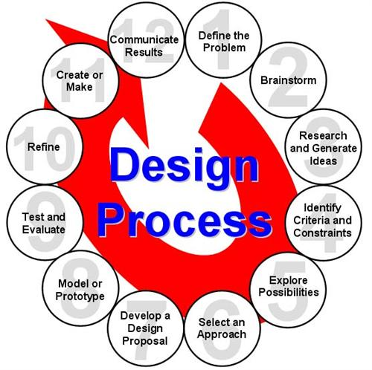
The 12 Steps of Design:
Orange Group Unity Bot
Imyre, Bria, Josh, Ryan, Sam

Slide 2
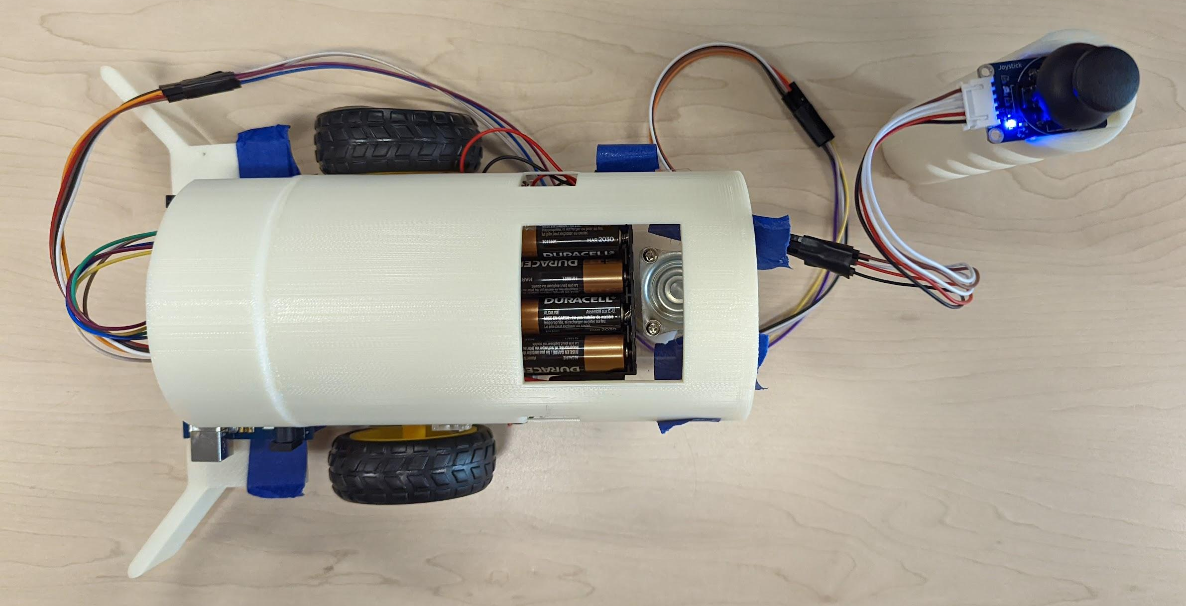
Define a problem
Our group was tasked with creating a low-cost, reproducible robot for children in developing countries.

Slide 3
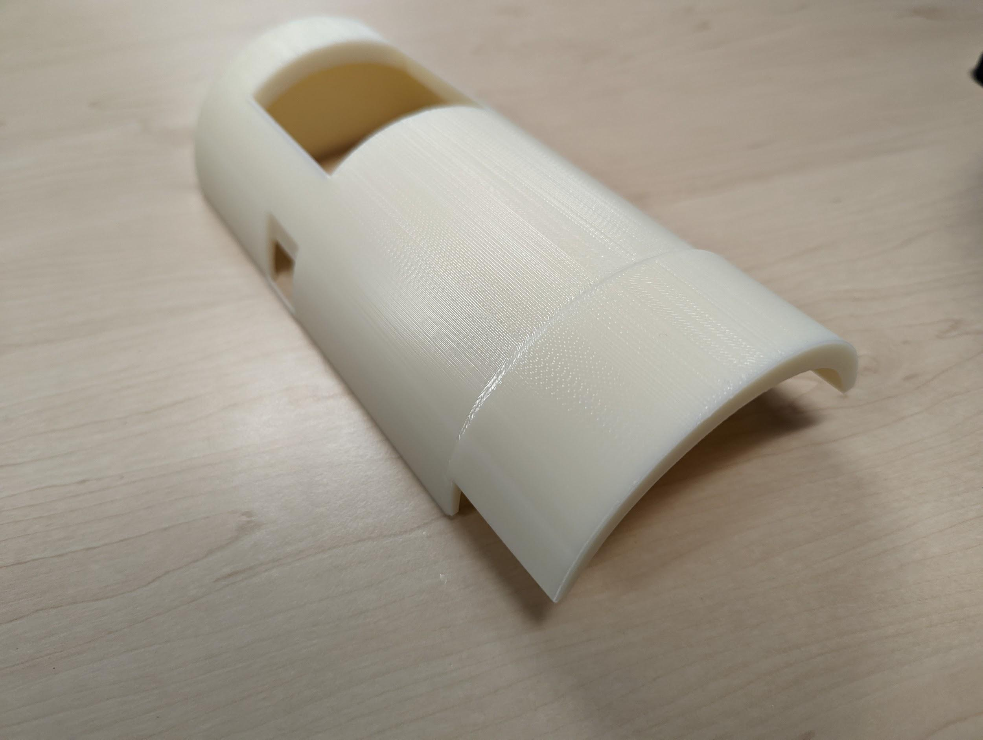
Brainstorm possible solutions
One of our solutions is a plow in the front of our robot to enable us to push small objects. Another solution we made was a top piece on top of our robot for more durability.
We also decided on a joystick, to be able to control our robot in real time.

Slide 4
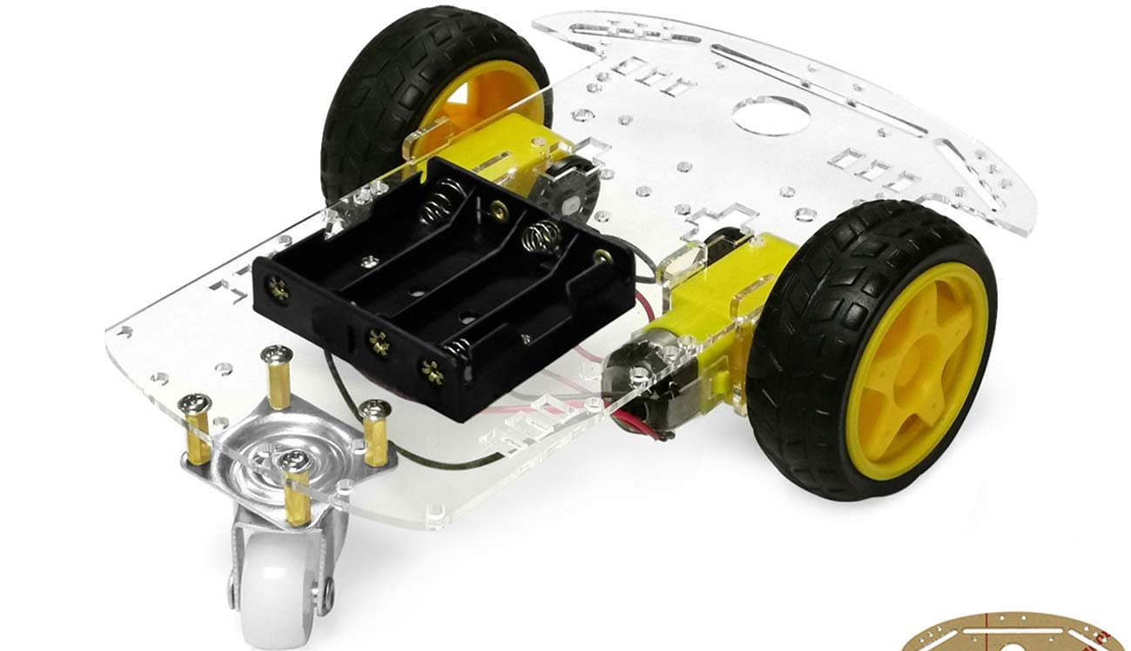
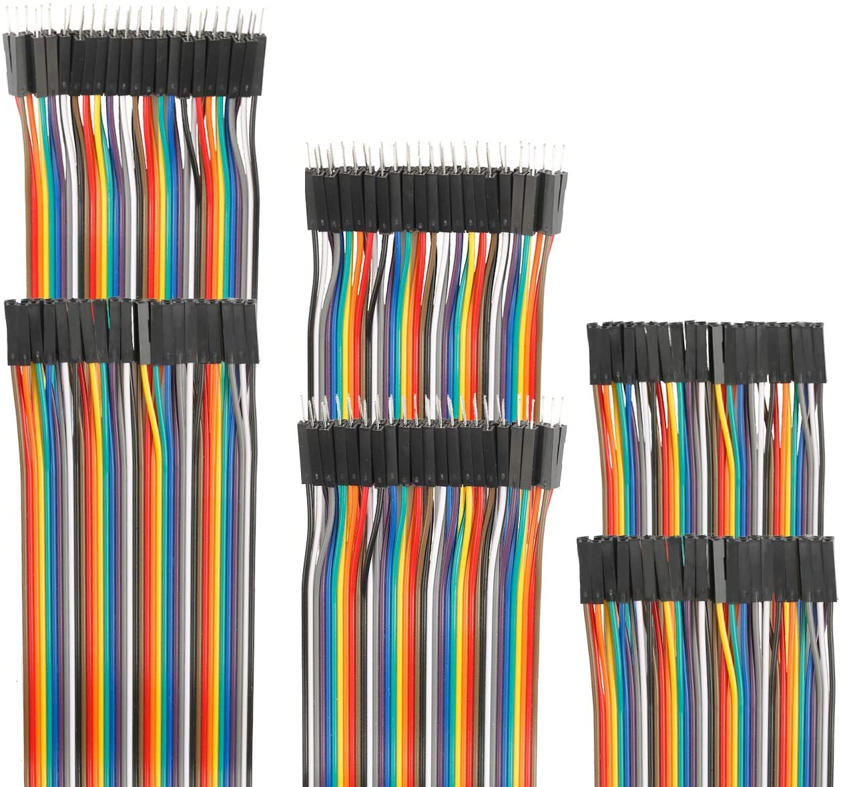
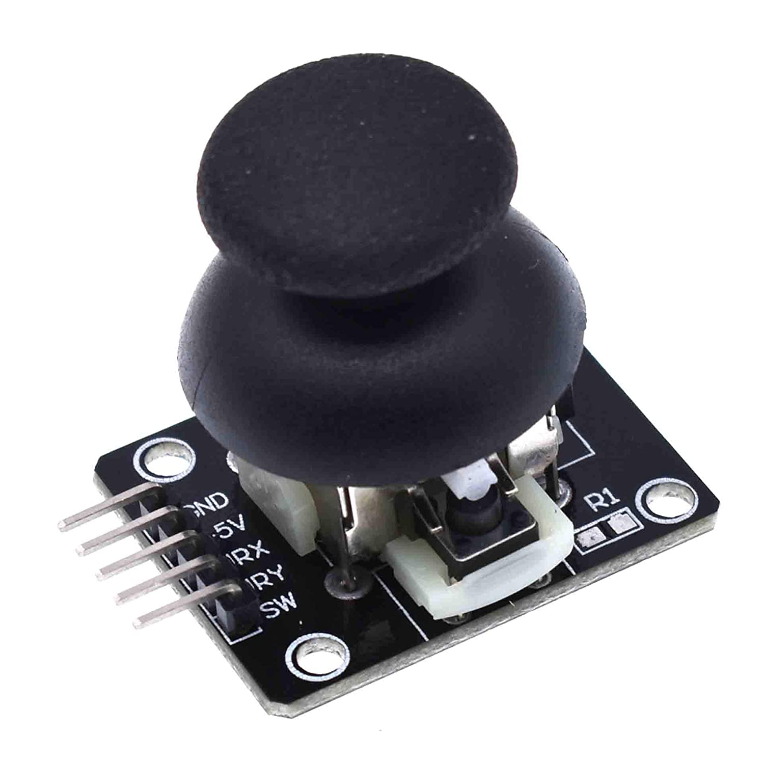
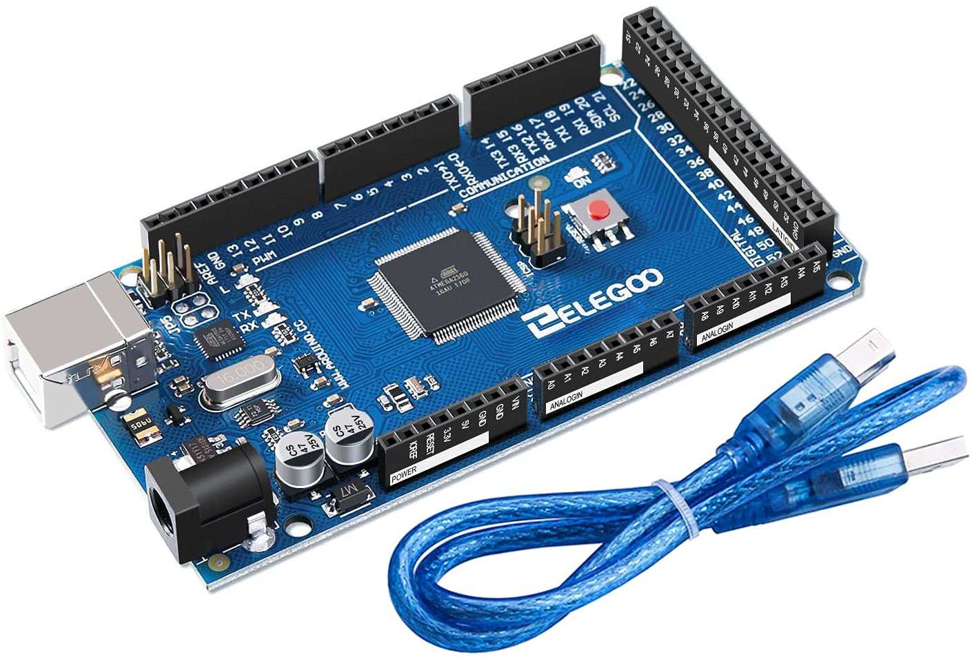
Research Ideas/ Explore possibilities
We researched different electronic parts on amazon to find the products that were cheap, functional, and compatible. We also considered different setups, such as 4 wheels, an arm, or an app to control it.
Parts available on Amazon

Slide 5
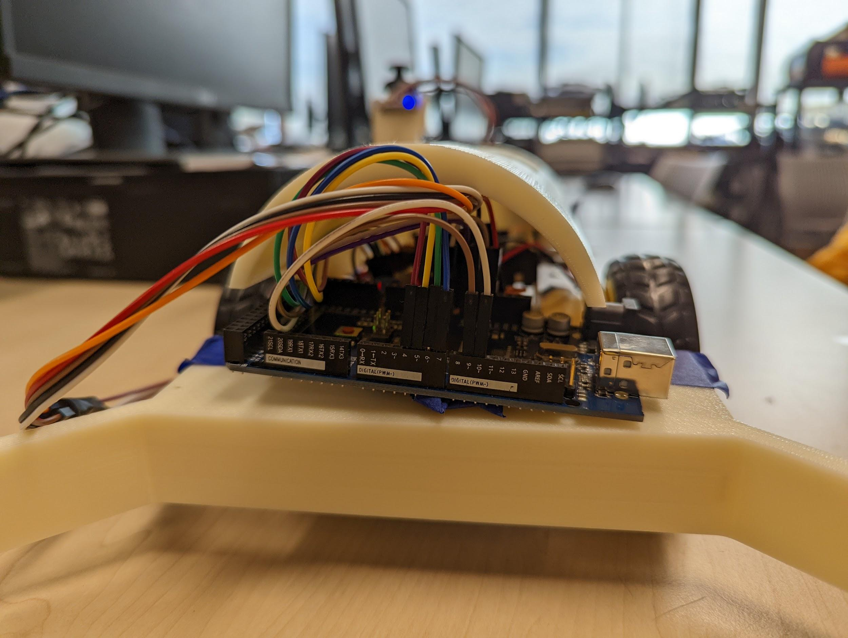
Establish Criteria And Constraints
We looked through all of the constraints and discovered that we weren't allowed to make the robot cost over $50, so it could be more affordable. We also saw that the robot had to contain an object manipulator.

Slide 6
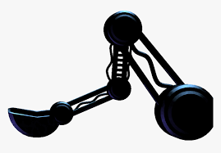
Consider Alternative Solutions
The solutions that we were considering but weren’t able to do were adding a lifting device to enable us to lift small objects off the ground. Another solution we were considering was adding a material to the tires like a small shell around each tire to keep them from wobbling and to stay in place just in case the come into collision.

Slide 7
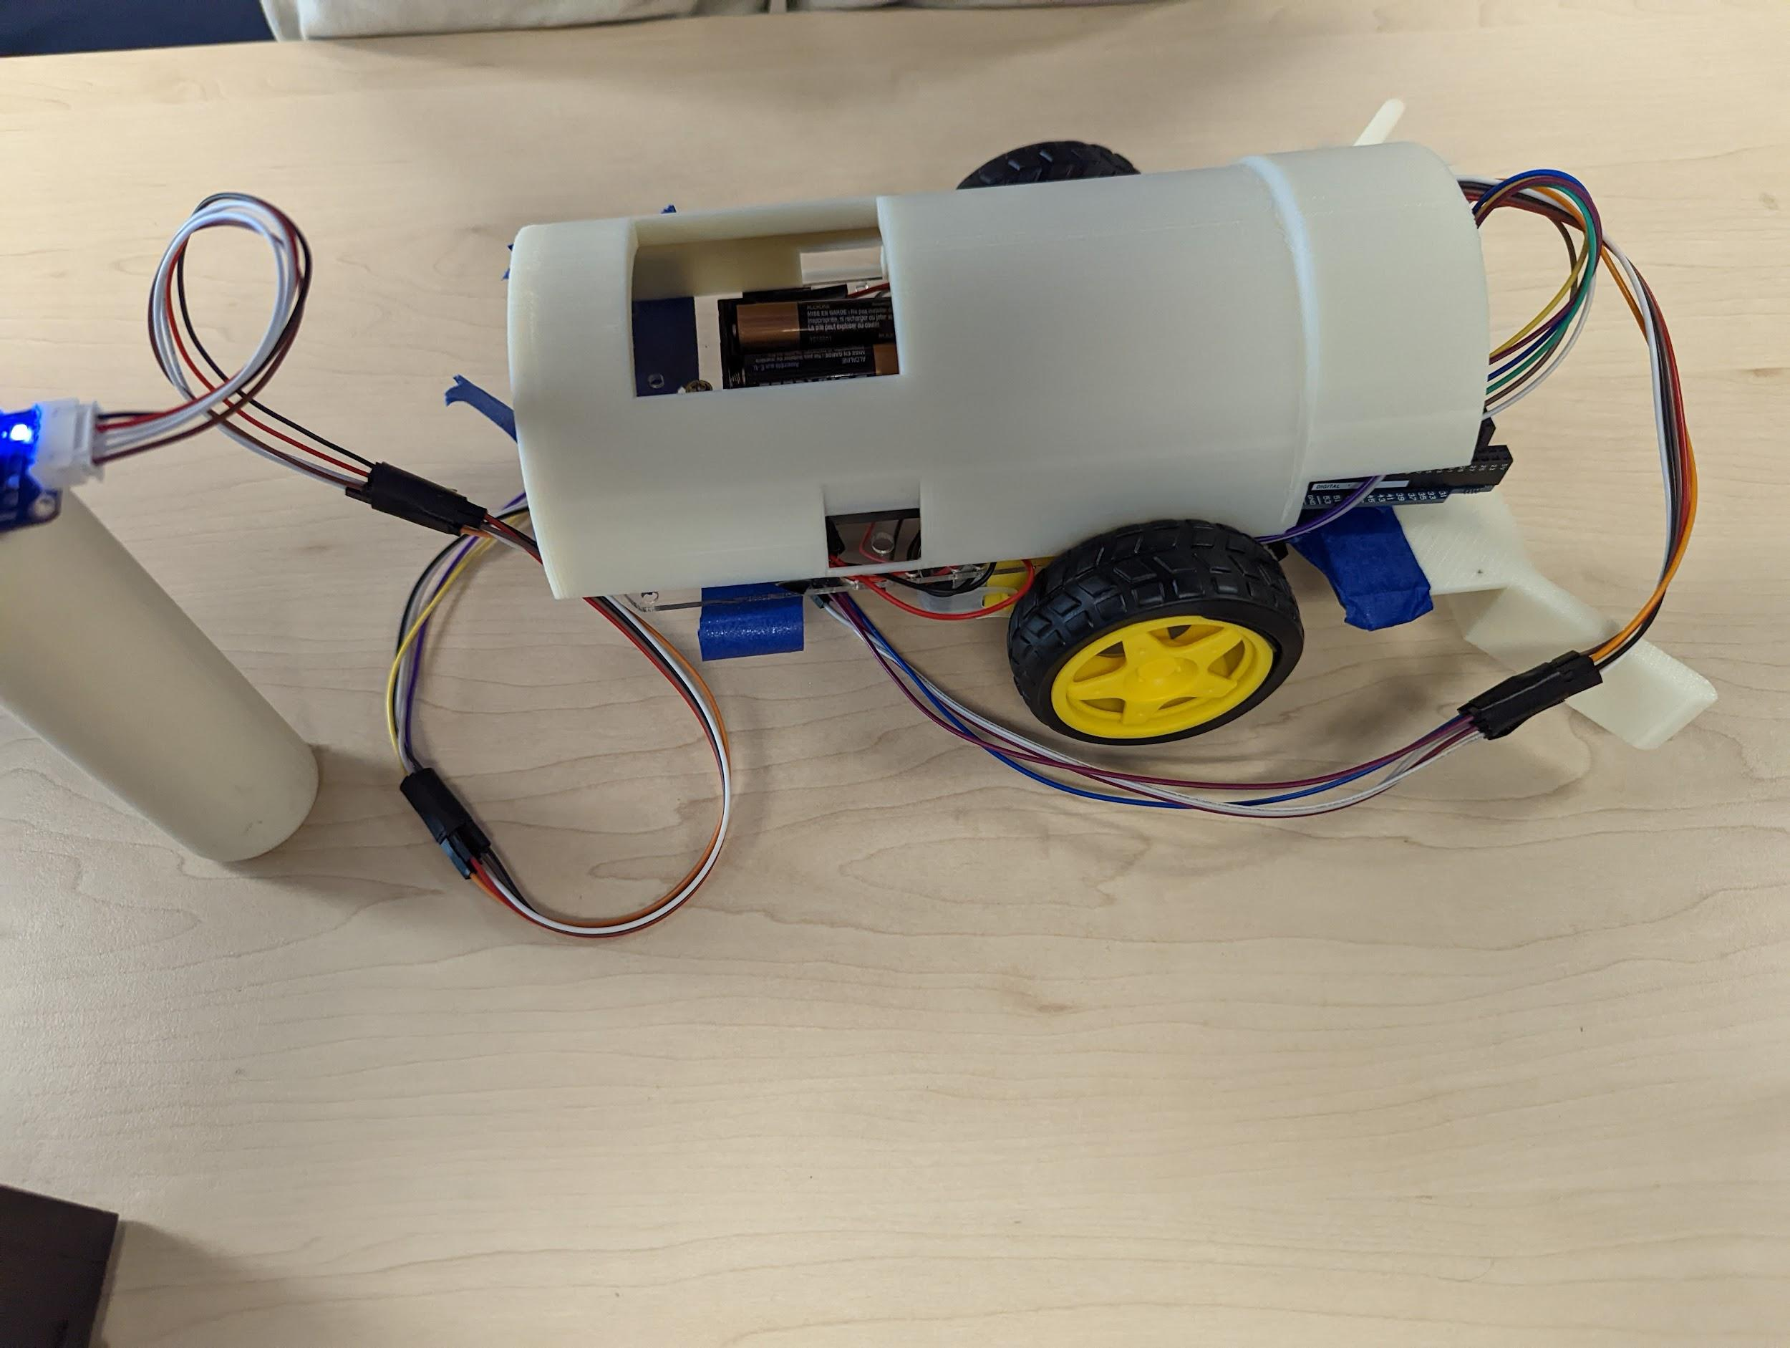
Select An Approach
In order to solve our problem, we looked on amazon for robot parts that cost under $50. Once we found some that totalled to about $48 we ordered it. We decided that we wanted to 3D print the plow. We created the model for it on onshape and had it printed out along with the joystick.

Slide 8
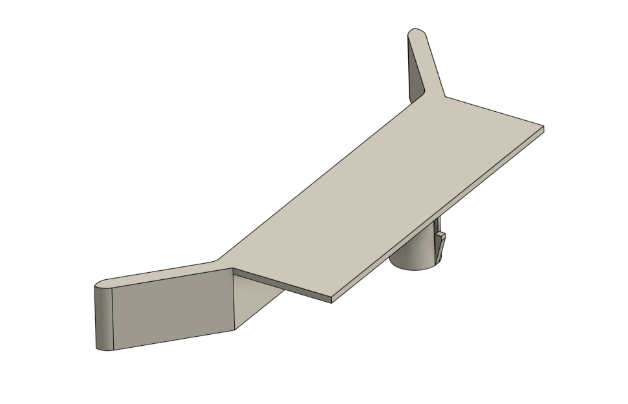
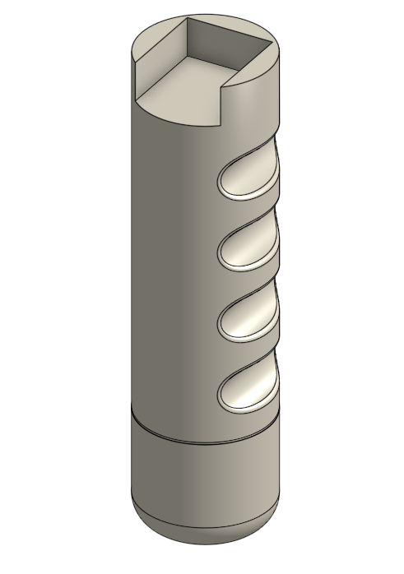
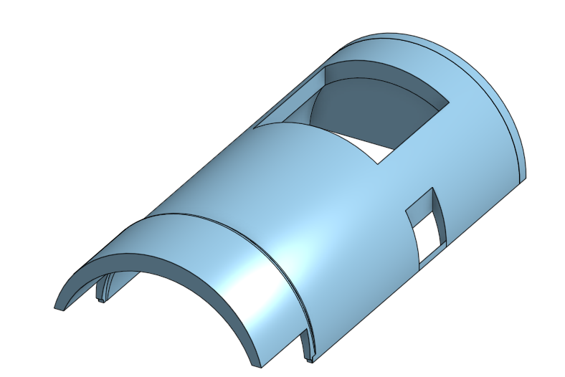
Develop A Design Proposal
Our thought process for the design was that we simply needed a affordable robot design, incorporating two motors. Once we had that, we added a 3D printed plow for our object manipulator, a handle to hold the joystick, and finally a shell to protect all of our wires and circuit boards from any external damage.
Open window for battery access
Lever locks into place
3D Printed parts

Slide 9
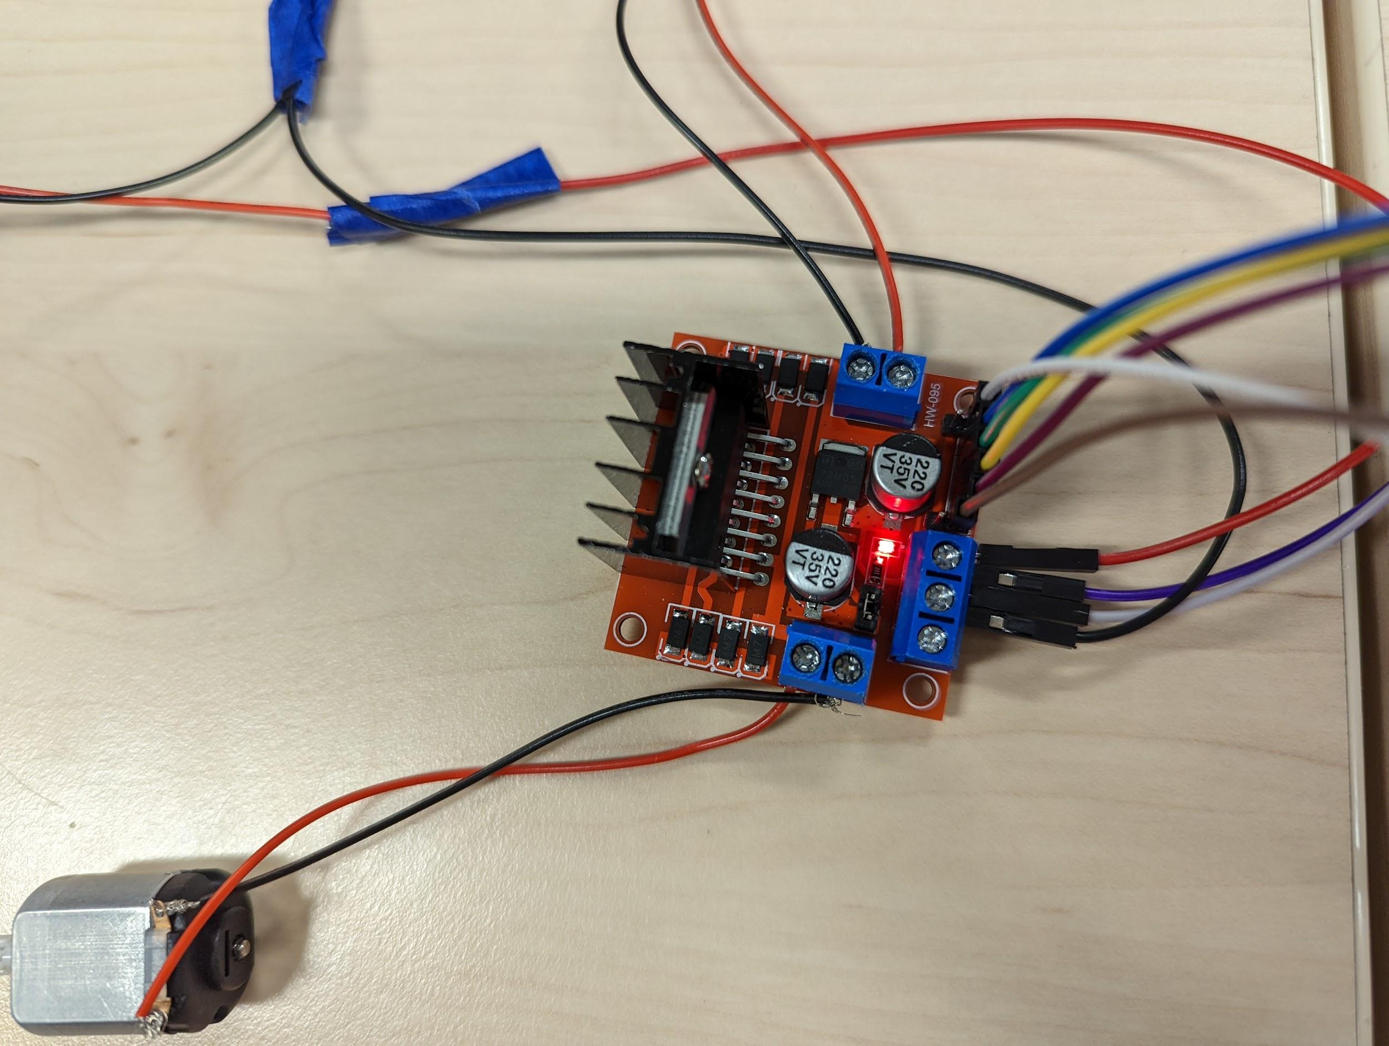
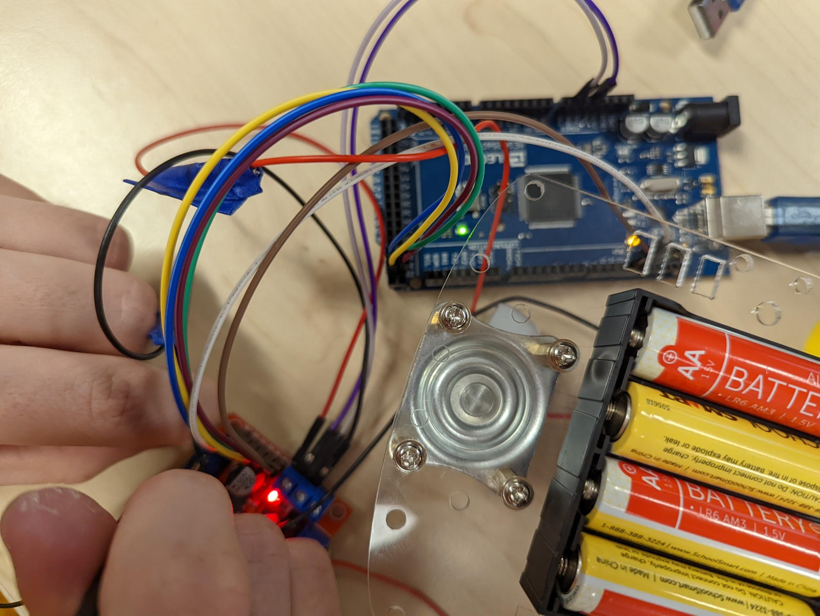
Make A Model Or Prototype
We constructed a series of electronic circuits, making a layout for the wires to connect the arduino, motor controllers, and motors.
PWM wires to Arduino
Prototype wire setup
USB Cable to PC
Motor power wires
Motor
Motor controller
Battery Pack: 6V

Slide 10
Test and Evaluate
We test drove our robot on the floor, and found problems in the steering, and the mobility. We decided that we would fix this, add more wires, and rewire the copper connections.

Slide 11
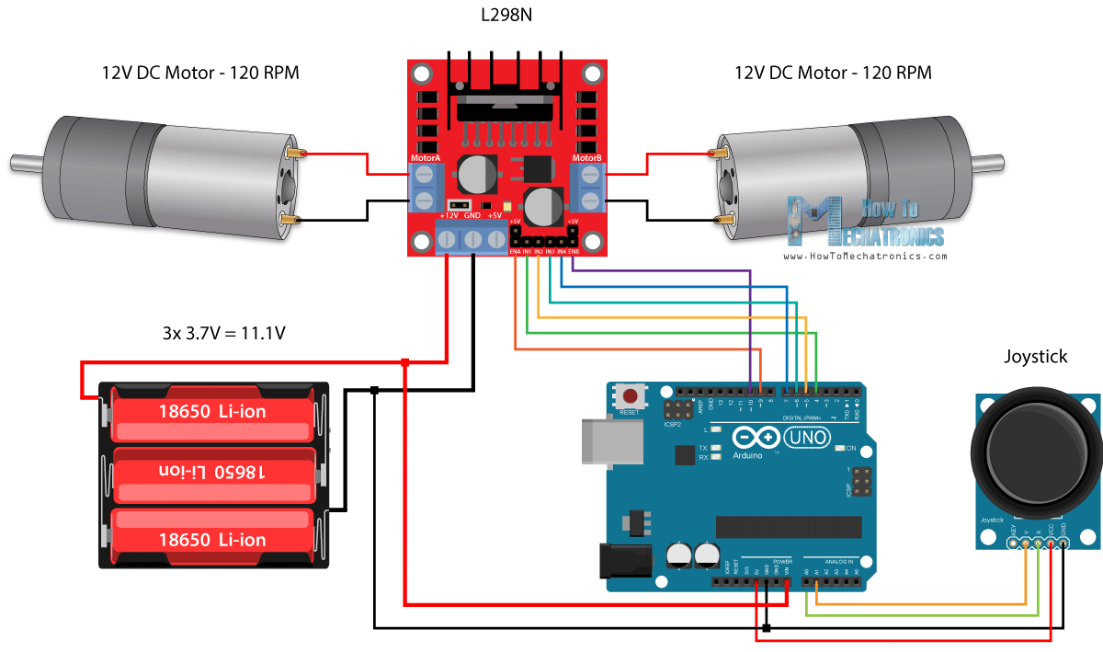
Refine The Design
We integrated multiple custom 3D printed parts, and changed the organization of the PWM wires. We also secured the copper connections with electrical tape.
We taped down each component to the final robot chassis, and placed the shell on top.
Taped wires
Reference
Image
Used
Taped wires

Slide 12
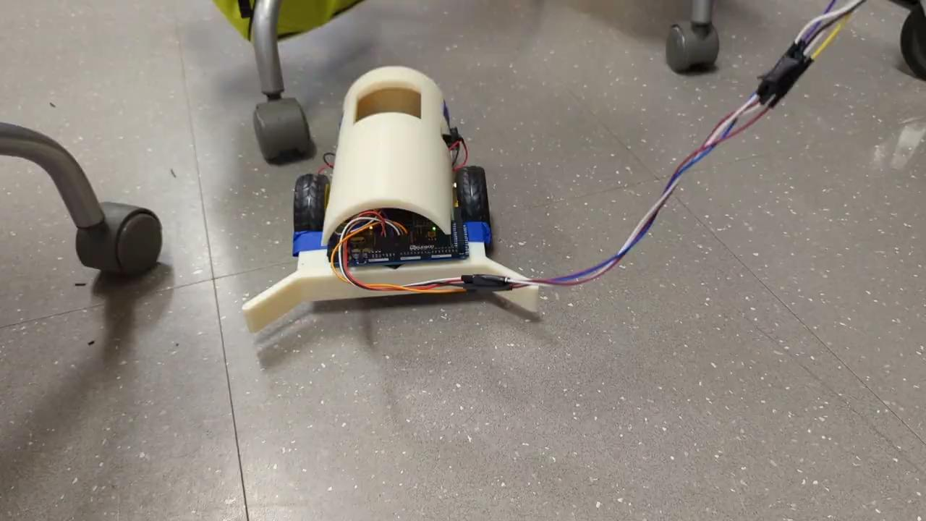
Create or Make
We took everything we learned from testing, and finished making a final design for our unity bot project. It features 2 independent wheels, and a trolley wheel in the back. It also sports a plow to push around small objects, and a joystick in a remote for real-time control.

Slide 13
Communicate Results
We have an instagram page for our team, as well as a website.
https://11383149.wixsite.com/website
https://www.instagram.com/orangegrprobotics/?hl=en
Right now, we are making a slideshow video presentation.

Slide 14
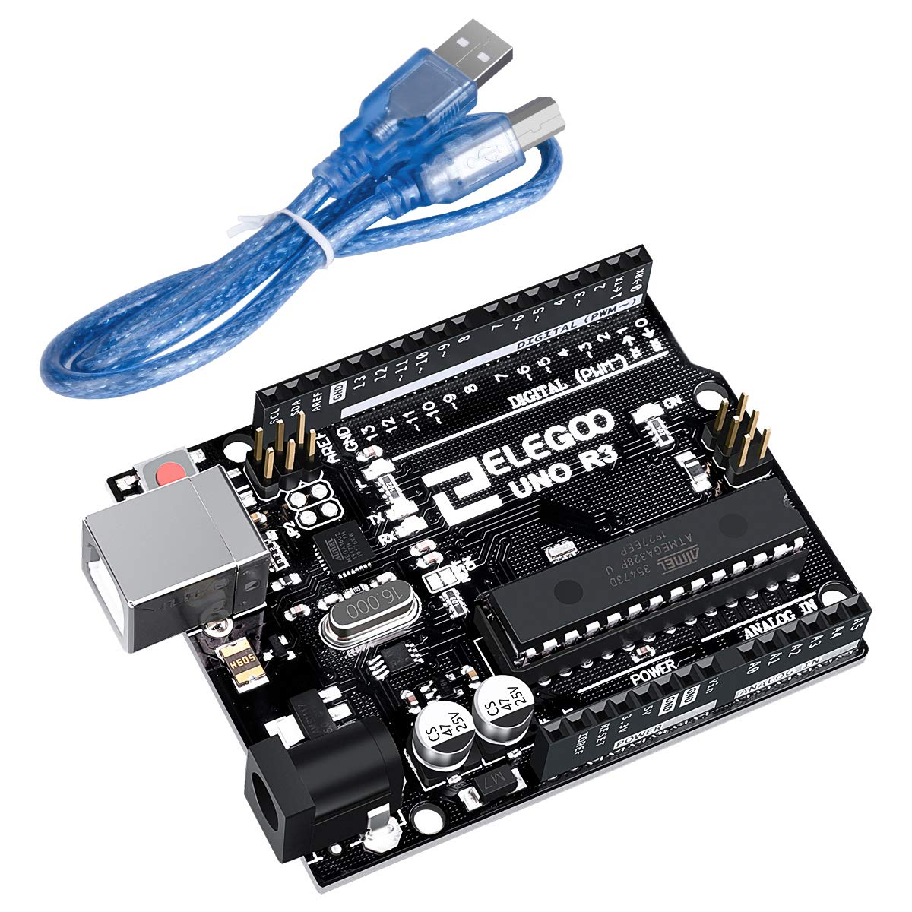
Cheapest Possible Reproduction of Products:
Some extra features can be added, but here is the most basic list:
Elegoo uno R3 Board $18.99 (works with arduino sketch) Link
L298N motor controller $4.50 (9$/2) Link
Chassis Kit: $11.99 Link
M to M Wires for Arduino $7 Link
Joystick for Arduino $5 Link
TOTAL COST: $47.48 (prices may fluctuate depending on provider)

Slide 15
Thank you!

